Slide 1
How to insert a drawing or an image to a slide
Ting-Hsuan Liu

Slide 2
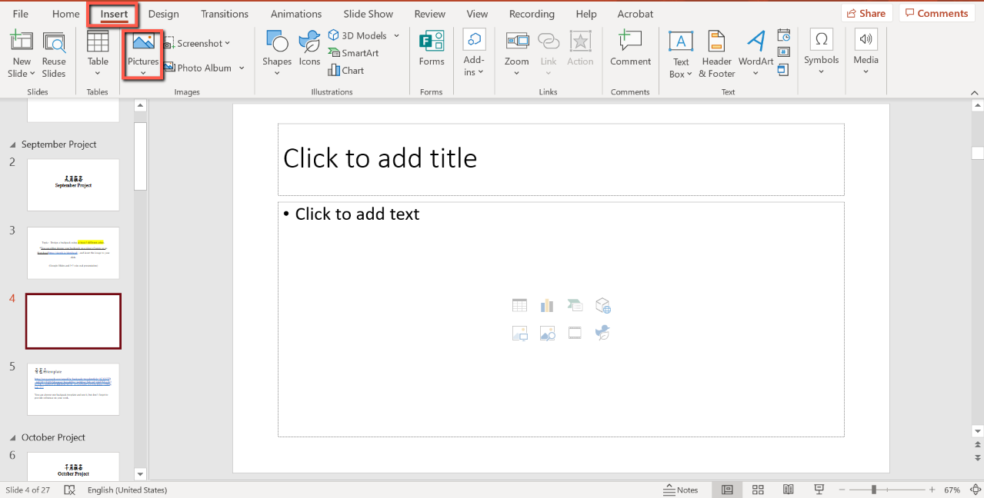
Steps to insert image or drawing Click “insert”→ Click “Pictures”→ Click “This device”

Slide 3
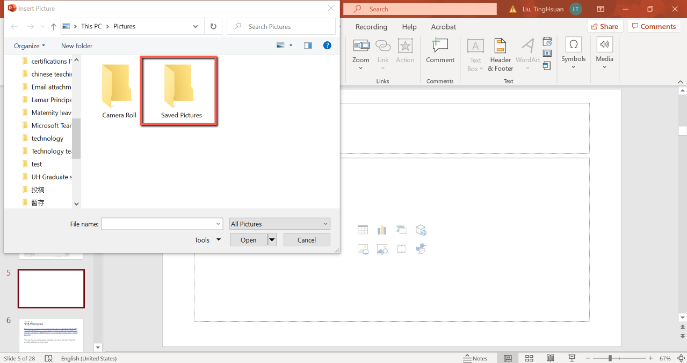
Select the folder where you save the file *I’ll suggest you save it on the desktop.

Slide 4
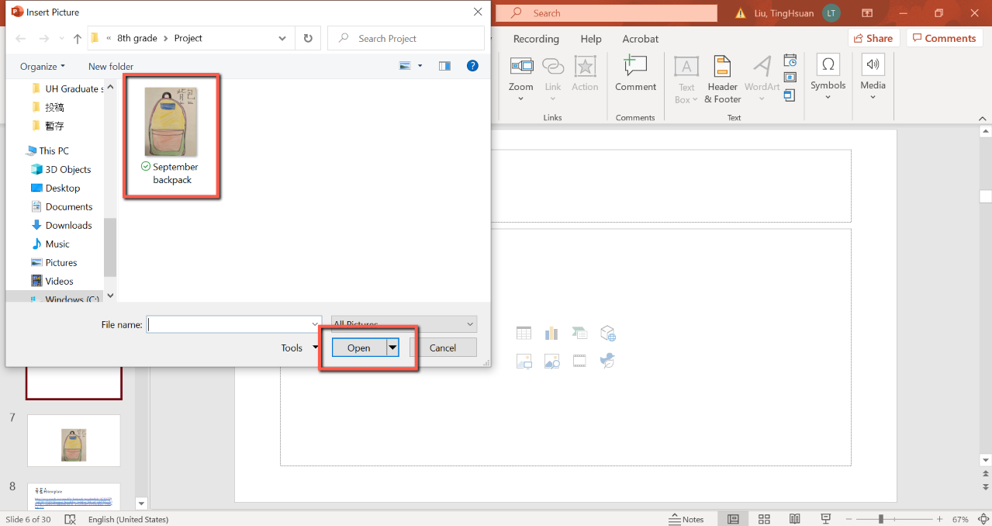
Select the image → Click “Open”

