Slide 1
Grade 4 Math
Unit 1: P1 Establish Math Routines And Represent Place Value Whole Numbers And Decimals

Slide 2
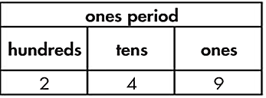
位值 Place Value
The position of a digit in a number that is used to determine its value.

Slide 3
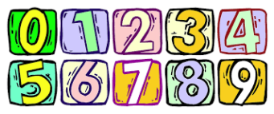
数位 Digit
Any one of the ten symbols used to write numbers: 0, 1, 2, 3, 4, 5, 6, 7, 8, 9.

Slide 4
标准式 Standard Form
113
A number represented with digits.

Slide 5
有乘法的展开式 Expanded Notation
8.79
(8 x 1) + (7 x 0.1) + (9 x 0.01)
A number represented as the sum of the product of each digit within a number multiplied by the value of each digit’s place value position

Slide 6
小数 Decimals
.56
Numbers between whole numbers with one or more digits to the right of the decimal point that represent part of one whole.

Slide 7
整数 Whole Number
7.75
All counting numbers such as
0, 1, 2, 3, … infinity.

Slide 8
小数点 Decimal Point
.56
Decimal Point
A dot separating the ones and tenths place in a decimal number, read as “and”

Slide 9
十分位 Tenth
0.1
One of ten equal parts of a whole; one tenth is composed of ten hundredths; one who is composed of ten tenths.

Slide 10
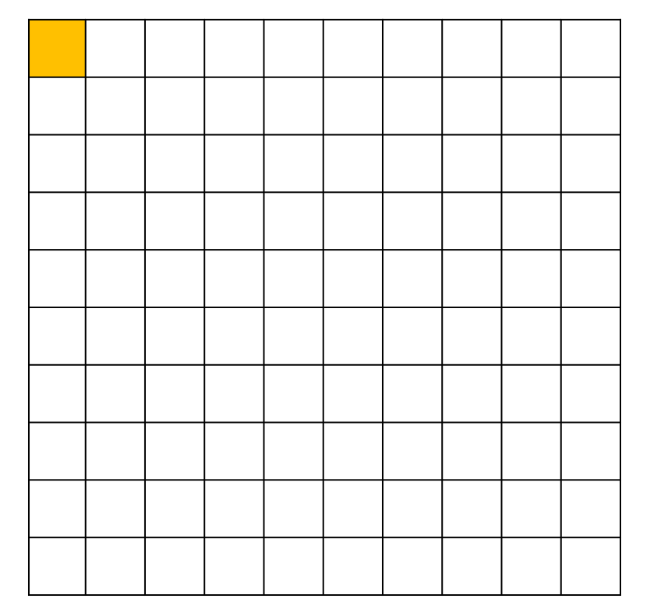
百分位 Hundredth
0.01
One of 100 equal parts of a whole; one whole is composed of 100 hundredths

Slide 11
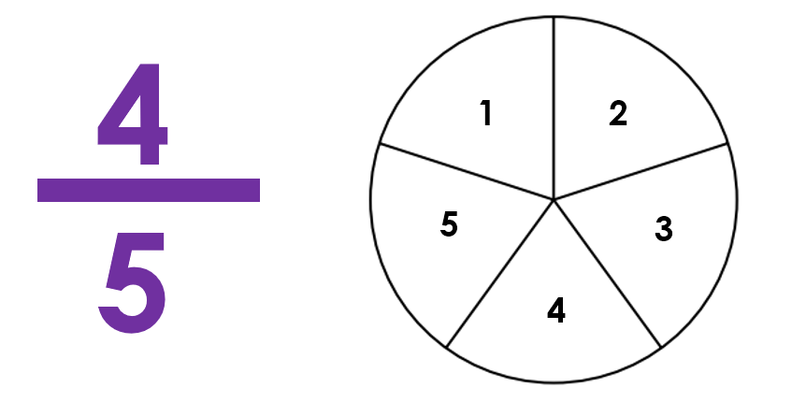
分数 Fraction
A number that represents a part of a whole.

Slide 12
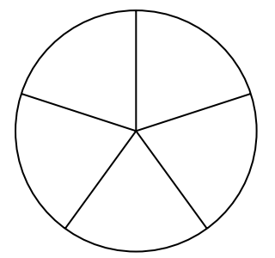
分母 Denominator
4
5
1
2
5
3
4
Tells the total number of equal parts or groups to which the whole or group has been divided

Slide 13
分子 Numerator
Counts how many equal parts are described

Slide 14
带分数 Mixed Number
7.75 or 7
75
100
A whole number and a fraction or a whole number and a decimal

