Slide 1
Grade 4 Math
Unit 2: Relate Fractions to Decimals

Slide 2
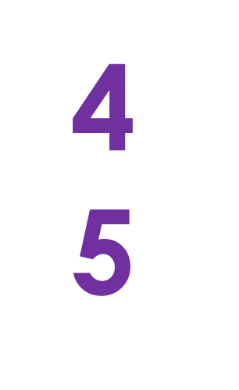
公分母 Common Denominators
2
When two fractions have the same denominator.

Slide 3
单位分数 Unit Fraction
1
3
A fraction with a numerator of 1. A unit fraction represents one part of a whole that has been partitioned into a given number of parts.

Slide 4
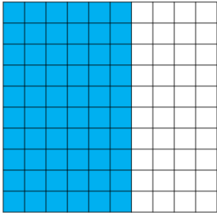
等值小数 Equivalent Decimals
.6
.60
Decimals that name the same amount

Slide 5
相等分数 Equivalent Fractions
Fractions that name the same part of a whole region, set, or distance on a number line.

Slide 6
假分数 Fractions Greater than One
5
3
A fraction whose numerator is greater than its denominator, sometimes referred to as an “improper fraction.”

Slide 7
最大公因数 Greatest Common Factor
16
8
1
2
4
16
8
4
1
2
8
4
The greatest common factor shared by two or more numbers.

Slide 8
最小公倍数 Least Common Multiple
3, 6, 9, 12
4, 8, 12, 16
The smallest number that is a multiple of two or more numbers.

Slide 9
带分数 Mixed Number
7 = 7.75
75
100
A whole number and a fraction or a whole number and a decimal.

Slide 10
数线 Number Line
0
1
2
3
4
A line with equally spaced ticks named by numbers

Slide 11
对分 Partition
To break into equal size pieces.

Slide 12
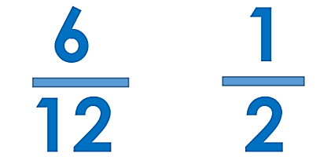
最简单的分数 Simplest Form
The form of a fraction when the numerator and denominator have the number 1 as the greatest common factor.

