Slide 1
Grade 4 Math
Unit 3: Represent, decompose, and Compare Fractions, and determine fraction equivalence

Slide 2
标准分数 Benchmark Fractions
0
1
2
3
1
4
4
4
4
Fractions that are easy to round to and add and subtract with.

Slide 3
相等分数 Equivalent Fractions
Fractions that name the same part of a whole region, set, or distance on a number line.

Slide 4
最小公倍数 Least Common Multiple
3, 6, 9, 12
4, 8, 12, 16
The smallest number that is a multiple of two or more numbers.

Slide 5
最大公因数 Greatest Common Factor
16
8
1
2
4
16
8
4
1
2
8
4
The greatest common factor shared by two or more numbers.

Slide 6
假分数 Fractions Greater than One
5
3
A fraction whose numerator is greater than its denominator, sometimes referred to as an “improper fraction.”

Slide 7
带分数 Mixed Number
7 or 7.75
75
100
A whole number and a fraction or a whole number and a decimal.

Slide 8
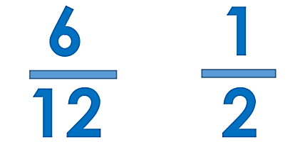
最简单的分数 Simplest Form
The form of a fraction when the numerator and denominator have the number 1 as the greatest common factor.

Slide 9
单位分数 Unit Fraction
1
3
A fraction with a numerator of 1. A unit fraction represents one part of a whole that has been partitioned into a given number of parts.

